Slide 1

How upload the projects on GitHub
vamshi

Slide 2
Create a GitHub account: Go to github.com and sign up for a new account if you don't have one already. Once you have an account, log in to GitHub.

Slide 3
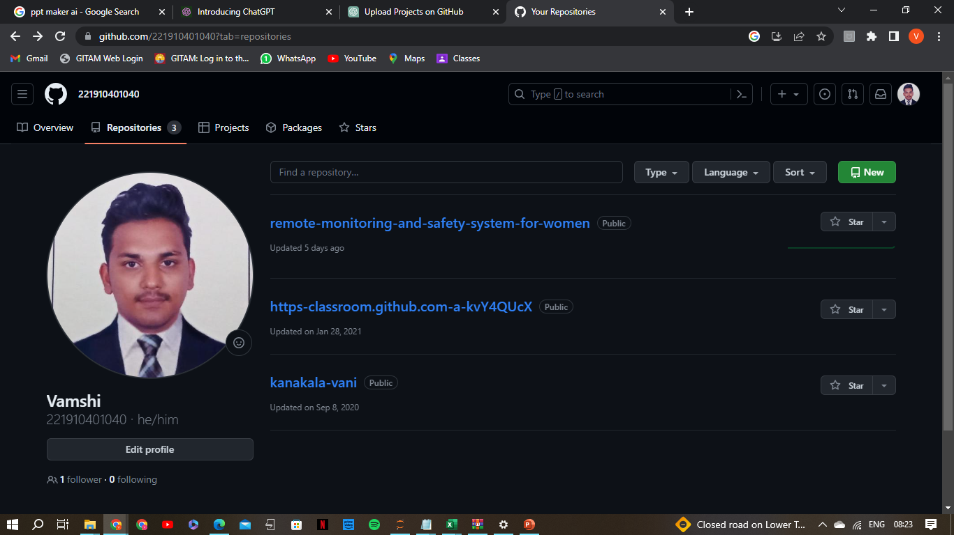
Create a new repository:
A repository is a container for your project on GitHub.
Click on the "+" sign on the top-right corner of the GitHub page and select
"New repository". Give it a name and an optional description.

Slide 4
Initialize a Git repository locally:
If your project is not already a Git repository, navigate to the project's directory in your terminal or command prompt and run the command git init. This will initialize a new Git repository.
Add files to the repository:
Use the command git add <file> to add the files you want to include in the repository. For example, git add index.html will add the "index.html" file.

Slide 5
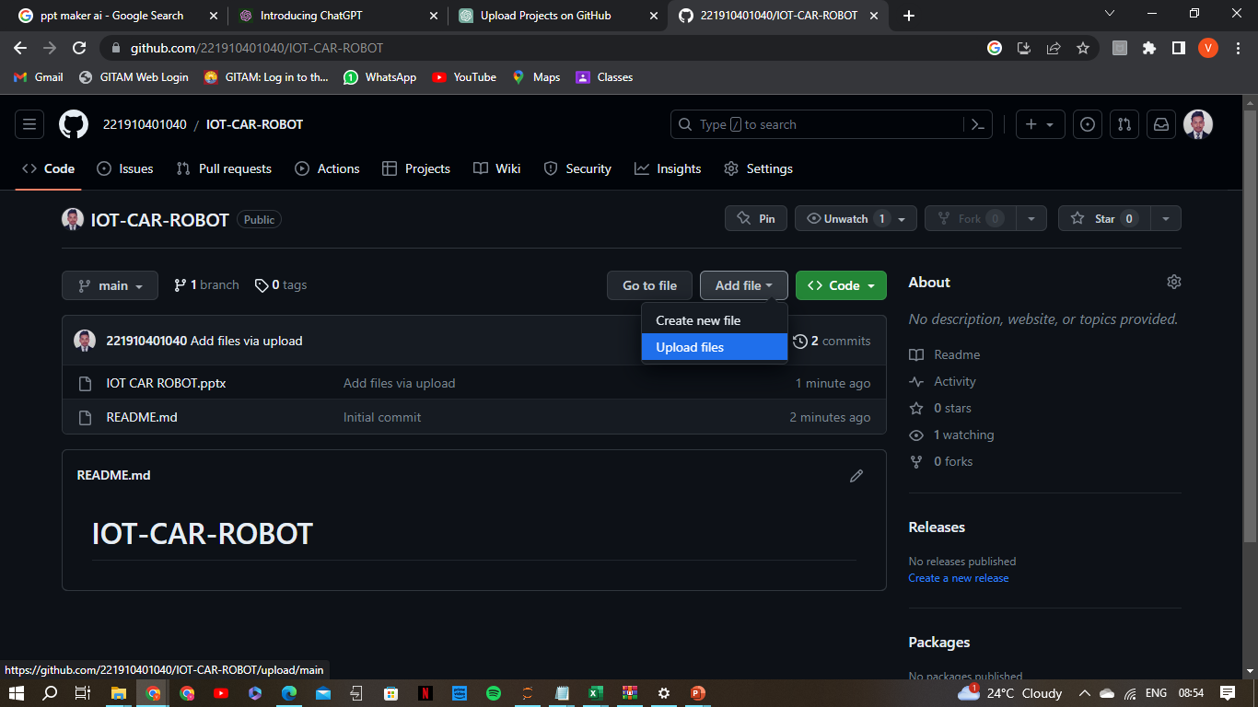

Slide 6
Push to GitHub:
Finally, use the command git push -u origin master to push your local repository to GitHub. This will upload your files and commit history to the remote repository.

